Slide 1
The Team:
>Mentor: Ms.Indira
>Team Leader: Bachina Abhinay - 19311
>Team Players:
Bhargav Inturi -19324
P Jagadish venkat kumar - 19339 P Teja - 19341
K. Gnaneswar - 19230 Bharath Schneider - 19213 M Phani -19332
Proﬁles (click here)

Slide 2
The Objective:
>> Almost all Educators /Youngsters are Social Media users where almost all cyber-crimes or addictions to Social Media is also the same youngsters/Education persons.
>> So to get more awareness on this type of issues we planned to go for a project trail on students those who can able to learn more and can spread awareness from there.

Slide 3
An Project Overview:
>Firstly we got an Project Approval from our respective Mentor by Explaining all our project overviews.
Our ﬁrst Phase is to Publish a Soft/hard document copies that includes explaining about security,Rehabilitation, Cybercrime & Behaviour with all needful links and graphs which make by our own.
Our 2nd phase is to conduct a Free Online webinar with a professional Speaker along with team participants. i.) We make posters, invitations cards, video promos as a ﬁrst set to invite all students, learners. ii.) With help of presentation we successfully complete our webinar.
our 3rd phase to conduct a quizzes and publish forms to take feedback from participants.
Resources:
We use MS Ofﬁce to make our presentations and all our virtual meetings held in Teams, Google meet.

Slide 4
Background of the problem:
challenge in Document model to prepare.
Team participants effort in ﬁnding complicated information to make document inreality.
Finding a Speaker for webinar.
Promotions, allowing participants to webinar

Slide 5
Focus Areas:
** *we focus mainly on Documentation which is issued to all near students in schools that may pass the information from one to one and we provide video recording links which is useful to them who have mobiles to watch that understand clearly about scams on Social Media***
>>> we t complete our project approval by Jan-2022
>>> we completed our phase-1 Documentation by 6th Feb-2022
>>> we completed our free Webinar meeting with all promotions and posters etc by 16th Feb-2022.
>>> All our Final Project Submissions with necessary proofs /Attachments to be completed by 23rd feb-2022.

Slide 6
Achievements:
Participants Abhinay & Bhargav take charge on Documentation and Articles publish.
Team Participants Teja & Jagadesh as volunteer promote our Project , making webinar presentations, preparing Forms to take Quizzes..
Gnaneswar, Bharath & Phani are helpful in Documentation and Final Project Submission Process and important in planning meetings, Evaluators and
Co-ordinators.

Slide 7
Challenges involved in project:
>> Work Distribution
>> Lack of communication due to virtual work.
>> Blueprint to prepare Document Hard/Soft copy
>> Scope Creep

Slide 8
The Road Ahead:
This is a Great Experience for all us to participate in Student Social Responsibility Programs which helps us in Improve group Discussions, Aware of different Articles from Internet that hidden from our eyes till the day.
Abhinay- Personally Recommend to all Other institutions who not aware of all this, ask them to involve their students into the program that may help them to gain Knowledge along freshness other than their studies .
Bhargav - Its Inspiration i personally always be in helping to all with necessary information.
Teja - making Documentation and paper articles etc are very joyful.
Jagadeesh - In future i personally always be in organizations that perform this type of volunteer Programs.

Slide 9
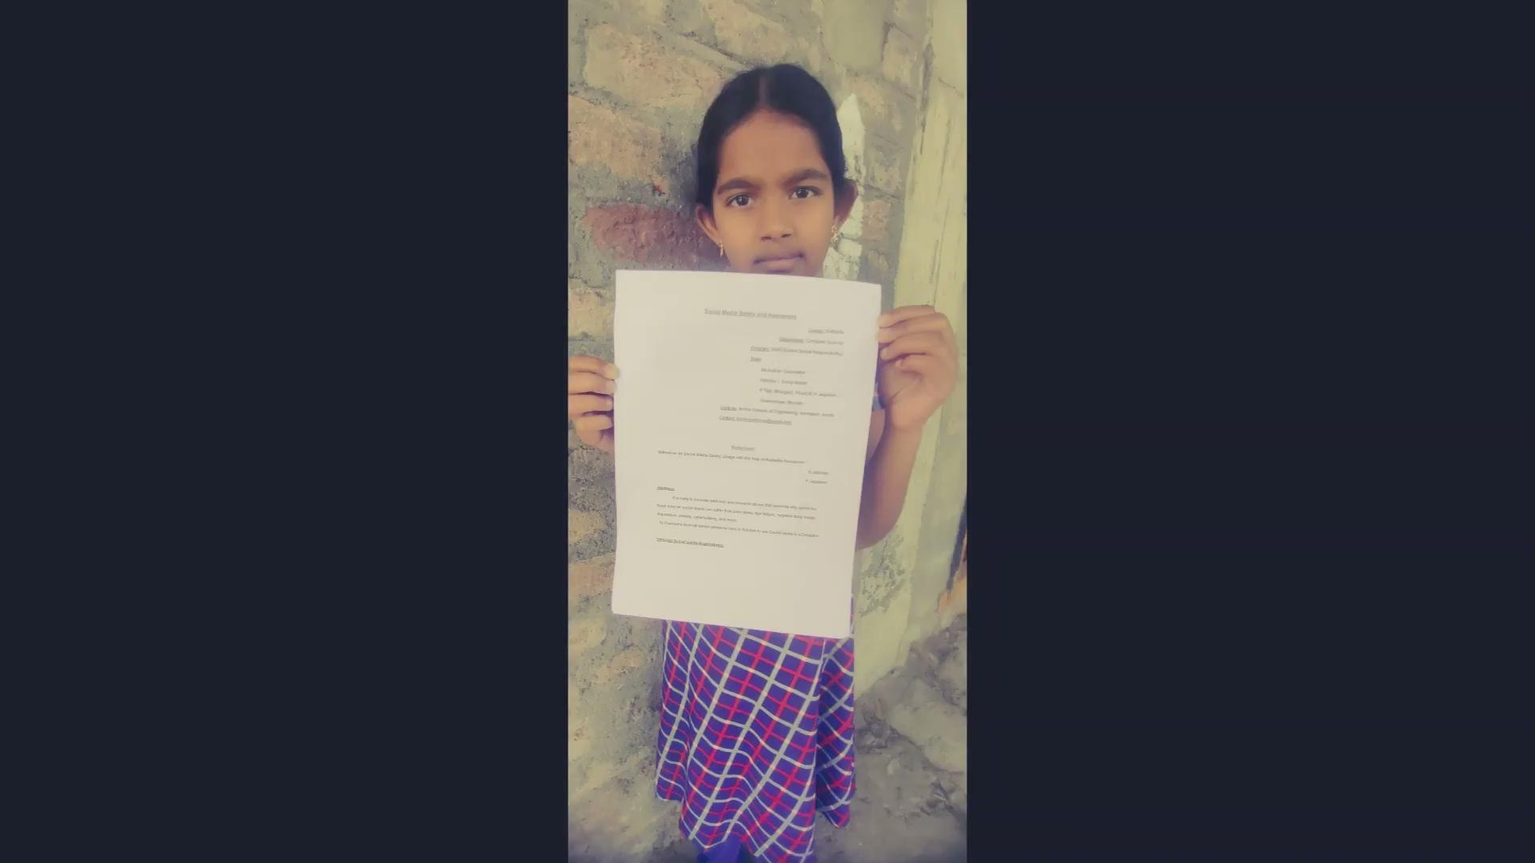
Image Gallery:
Following are Links :
>> Our Quiz and Feedback form Statistics
>> Invitation Poster for Webinar:
>> Gallery's

Slide 10
Acknowledgements:
“””We would Like to Thank our Mentor Ms. Indira for shining our project with great changes and with suggestions & with her tips we perform well in presenting. “””
And as a Scrub Master to my team SSR-44 i would tank to all my team Participants who helped me a lot to complete this service to public.
>> On what areas we are week , We always use google to know more data about it.
>> Thank You to www.ssr.amrita.ac.in for allowing us to participate in this type of social projects.
***This is a completely different experience for us which performed Virtually.***

Slide 11


